Slide 1
Baltic synchronization plan
Alexander Mondovic
ENTSO-E
Baltic Synchronization Stakeholder Workshop
20 December 2018, Tallinn

Slide 2
Baltic synchronization plan
1
Outcome of the Baltic Frequency Stability Study
2
Effects on other synchronous areas
3
State of play of ENTSO-E procedure (system extension process)

Slide 3
Baltic synchronization plan
1
Outcome of the Baltic Frequency Stability Study
2
Effects on other synchronous areas
3
State of play of ENTSO-E procedure (system extension process)

Slide 4
Baltic Frequency Stability Study
Scenario number 3 from previous studies
Synchronous interface on existing double circuit 400 kV AC line between Poland and Lithuania
New submarine HVDC link between Poland and Lithuania
Study contractor:
Institute for Power Engineering, Gdansk Division (IEN)
Professor Krzysztof Madajewski
Study consultant:
Professor Eckhard Grebe
HVDC link (new link in orange)
AC double circuit tieline

Slide 5
Schematic view
FI
SE
Building up the understanding of how Baltic TSOs will be interconnected and operated
EE
Existing HVDC links
LV
New submarine HVDC link between Poland and Lithuania (minimum 500 MW, maximum 700 MW of commercial capacity and 100 MW of overloading capacity)
AC interface: existing double circuit 400 kV line between Poland and Lithuania
LT
RU
PL

Slide 6
Purpose of the AC interface
FI
SE
In case of any outage in Baltic States and of their HVDC links, the Continental European (CE) system provides immediate support across the AC interface
But what if the AC interface itself fails?
EE
LV
LT
RU
PL

Slide 7
No physical flows > 100 MW on the AC interface
FI
If the AC interface fails, there is no AC support from CE
Support can be provided only via HVDC links
If the AC interface is used for physical flows, commercial capacity on HVDC links has to be blocked in advance to provide support in case of losing the AC interface, with less potential socio-economic benefit
SE
EE
LV
To avoid physical flows on the ACE interface, the commercial capacity CE/Baltic will in the first place be put on the HVDC link PL/LT
Physical flows on the ACE interface due to additional commercial transactions will have to be eliminated by counter-trading or, in the future, enabled by installing batteries counteracting the outage of the AC interface
LT
RU
PL
The AC interface will, from operational point of view, be used as “life insurance”

Slide 8
And what if there is another outage after the loss of synchronism?
FI
SE
Within the first 15 minutes after loos of synchronism Baltic and other TSOs will activate fast reserves (FRR) and decrease the flows on HVDC links
After this, the HVDC links will be able to provide support in case one of them or a generator in Baltic States fails
FRR down
EE
LV
Decrease flows, free a portion of HVDC links’ capacity !
FRR down
Next outage(s)
LT
RU
~
PL
FRR up

Slide 9
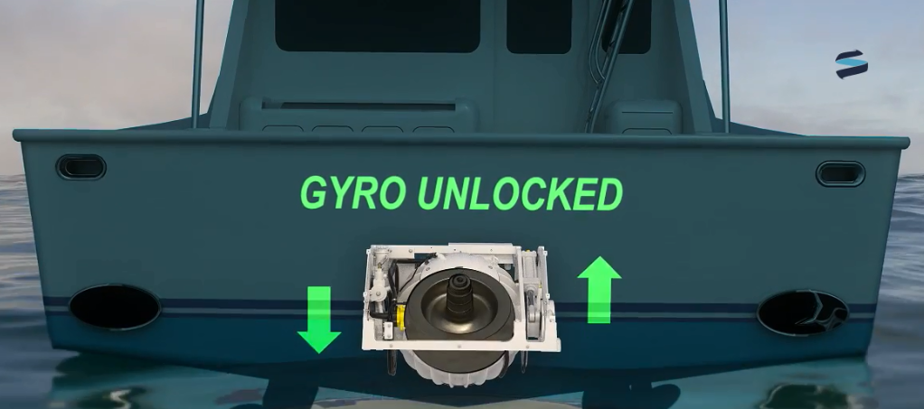
Keeping the necessary level of system inertia
Why?

Slide 10
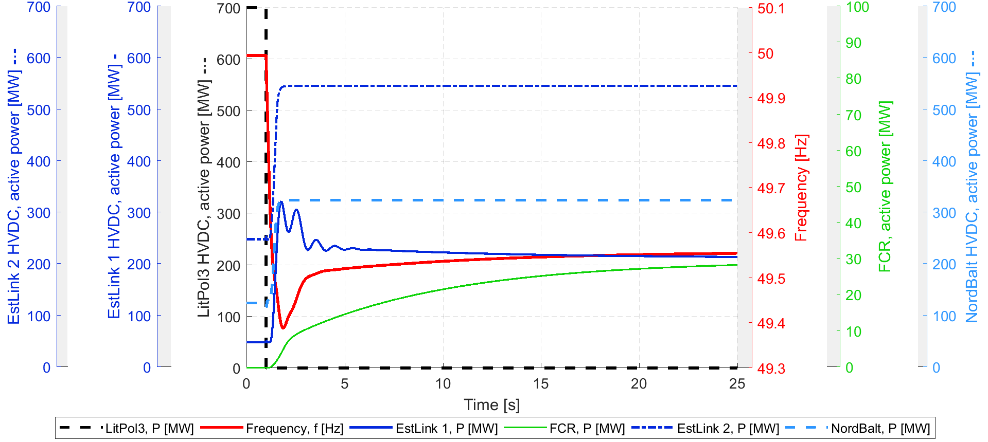
Because a too high Rate of Change of Frequency (RoCoF) can lead to a black-out

Slide 11
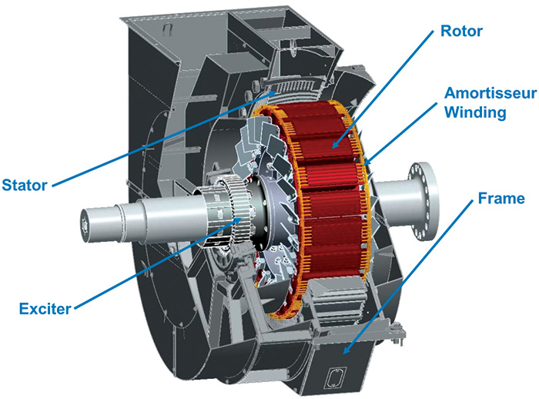
Synchronous condensers will have to be installed in Baltic States (at least 4 of them)
A level of inertia of 17’100 MWs has to be kept. This will be done with 4 new synchronous condensers with high inertia constants
Existing hydro units in LT and LV will have to contribute to inertia (in synchronous condenser operation mode) or else a total of 9 synchronous condensers will be necessary
This level of inertia will be kept permanently, i.e. all the time, also during synchronous operation

Slide 12
Costs for synchronous condenser action
Costs for keeping 17100 MWs by hydro units in SCm and new SCs
Costs for keeping 17100 MWs by new SCs

Slide 13
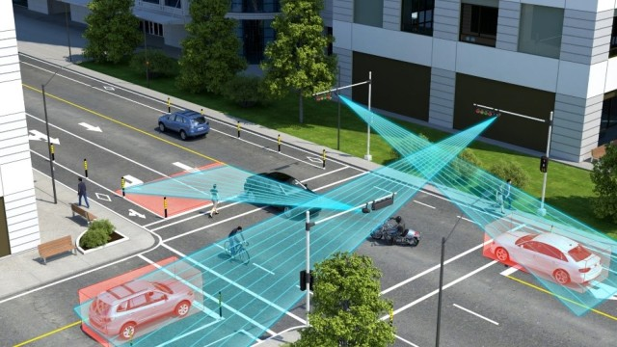
We need a brain – the Frequency Stability Assessment System (FSAS)
FSAS will collect all information from:
AC interface
HVDC links
Generating units
Synchronous condensers
And also from CE and Nordic synchronous area
FSAS will permanently propose optimal solutions for generation, flow, and settings

Slide 14
Requirements for synchronization – summary
To commission before synchronization:
New submarine HVDC link between Poland and Lithuania (minimum 500 MW, maximum 700 MW of commercial capacity and 100 MW of overloading capacity) – CAPEX: up to 650 mEUR (+ ca. 10% for overloading capacity)
At least four new synchronous condensers with high inertia constants in locations suitable also for increasing the short circuit power level and improving the voltage stability – CAPEX: 25 mEUR/unit
Frequency Stability Assessment System (FSAS)
To update before synchronization:
Control systems of the existing HVDC links
UFLS scheme
CAPEX for FSAS, control systems, and UFLS scheme: up to 10 mEUR

Slide 15
Baltic synchronization plan
1
Outcome of the Baltic Frequency Stability Study
2
Effects on other synchronous areas
3
State of play of ENTSO-E procedure (system extension process)

Slide 16
Impact on the CE synchronous area
During synchronous operation of the Baltic States Power System (BSPS) with Continental Europe (CE) power system
CE area provides FCR in case of all outages in BSPS
Via the submarine cable PL/LT, CE area provides up to 100 MW of fast frequency support in case of loss of synchronism of BSPS (on average once in about 22.5 years)
During island operation of BSPS
CE area (together with Nordic area) participates in activation of 700 MW of FRR for reducing the flows on HVDC links of BSPS (on average once in about 22.5 years)
CE area provides up to 400 MW of fast frequency support (normally less if the Nordic area provides a part of this support) in case of outages in BSPS during island operation (on average maximum once in a century)
These points have to be considered in operational planning of the Baltic TSOs and Polish TSO, PSE, all the time, but should normally not lead to additional costs in daily operation

Slide 17
Impact on the Nordic synchronous area
During synchronous operation of the Baltic States Power System (BSPS) with Continental Europe (CE) power system
Via existing HVDC links, Nordic area provides up to 100 MW of fast frequency support in case of loss of synchronism of BSPS, but only in case the submarine cable PL/LT is not available (on average maximum once in a century)
During island operation of BSPS
Nordic area (together with CE area) participates in activation of 700 MW of FRR for reducing the flows on HVDC links of BSPS (on average once in about 22.5 years)
Nordic area provides up to 400 MW of fast frequency support (normally less if the CE area provides a part of this support) in case of outages in BSPS during island operation (on average maximum once in a century)
These points have to be considered in operational planning of the Baltic TSOs and Nordic TSOs all the time, but should normally not lead to additional costs in daily operation

Slide 18
Baltic synchronization plan
1
Outcome of the Baltic Frequency Stability Study
2
Effects on other synchronous areas
3
State of play of ENTSO-E procedure (system extension process)

Slide 19
System extension process
The system extension process is in the competence of Regional Group Continental Europe (RGCE) of ENTSO-E
Steps
System extension application of Baltic TSOs submitted to RGCE on 9 October 2018
RGCE examined the application and found that the continuation of the process is feasible
RGCE created the Project Group Baltic and asked them to draft the Agreement with Baltic TSOs (including a Catalogue of Measures)
The Agreement with the Catalogue of Measures shall be ready for signature in spring 2019
Further steps
Implementation of measures
Island operation test
Trial synchronous operation
Permanent synchronous operation (in 2025 if everything is fine)

